Slide 1
Voting and Engaging the Community

Slide 2
To begin, a short video…

Slide 3
What is Voterise?
Voterise is a nonpartisan 501(c)(3) nonprofit. Founded in 2016, the organization is committed to increasing voter registration and turnout among 18-29 year olds and underrepresented groups. Although based in Utah, Voterise has a national reach through our digital channels and its ultimate goal is to build a more inclusive and vibrant democracy.
Voterise gives young people and others a voice in the future of our cities, state and nation.

Slide 4
The Facts
In 1980, Utah ranked 5th in voter turnout. In 2016, Utah ranked 39th.
In the 2014, only 8.1% of Utah’s 18-29 year olds voted, less than half
of the 19.9% national average.
A 1980, a Utah State House race was won by only 1,931 votes to the loser’s 1,930 votes. One single vote. In 2016, Suzanne Harrison lost to Lavar Christensen in House District 32 by 5 votes.
In 2016, there were 288,000 women in Utah who were eligible to vote and not registered. In 2018, this number increased to 316,000.

Slide 5
Some Recent Things…
Felons can vote in the state of Utah.
Homeless Utahns are eligible to vote.
They can use the cross streets of the
location where they sleep as their address.
You can pre-register at 16 and 17.
If you turn 18 on or before the November General Election Day, you CAN vote in the Primary Election while still 17.
Utah Women’s Voter Registration Day falls on February 14. The
Voterise-initiated HCR 16 was passed during the 2019 legislative session.

Slide 6
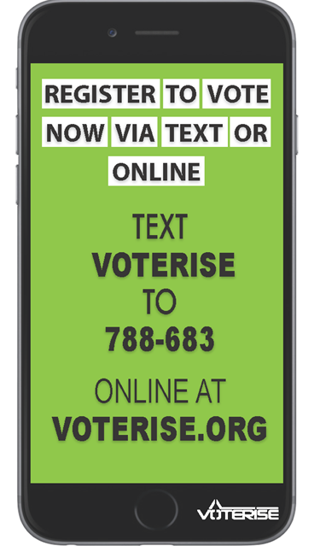
What Can You Do?
Know and share the facts!
Volunteer with Voterise!
Events
Organize voter registration drives
2020 Challenge

Slide 7
Remember, Your Vote Matters.
When One Vote Really Did Make a Difference
The races won by a single vote, in addition to the new 1910 Congressional election in New York, according to Mulligan and Hunter, were:
A 1978 race for Rhode Island state Senate was tied at 4,110 votes, and decided by a second runoff election. So was a 1980 race for New Mexico state House, at 2,327 votes for each candidate.
A 1982 state House election in Maine in which the victor won 1,387 votes to the loser’s 1,386 votes.
A 1982 state Senate race in Massachusetts in which the victor won 5,352 votes to the loser’s 5,351; a subsequent recount late found wider margin.
A 1980 state House race in Utah in which the victor won 1,931 votes to the loser’s 1,930 votes.
A 1978 state Senate race in North Dakota in which the victor won 2,459 votes to the loser’s 2,458 votes; a subsequent recount found the margin to be six votes.
A 1970 state House race in Rhode Island in which the victor won 1,760 votes to the loser’s 1,759.
A 1970 state House race in Missouri in which the victor won 4,819 votes to the loser’s 4,818 votes.
And a 1968 state House race in Wisconsin in which the victor won 6,522 votes to the loser’s 6,521 votes; a subsequent recount found the margin to be two votes, not one.

Slide 8
www.voterise.org
Hope Zitting-Goeckeritz, Director of Operations
(855) 725-VOTE (8683), ext. 505
hope@voterise.org

